Slide 1
Azure Storage

Slide 2
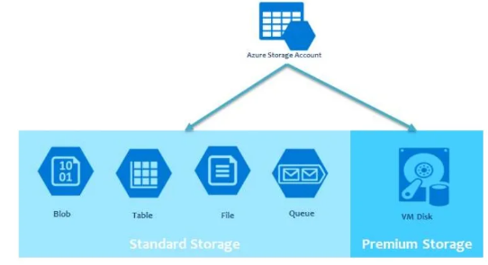
Azure Storage Account

Slide 3
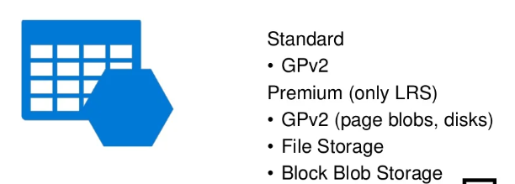
Storage Account Types

Slide 4
Types of Storage Account
Type of Storage account | Supported Storage service | Data redundancy options | Usage
Standard General Purpose V2 | Blob (Azure Data lake storage Gen2), Queue, Table, File share | LRS/GRS/RA-GRS/ZRS, ZRS/GZRS/RA-ZGRS | Standard storage account type for blob, file, queue, disks & tables.
Premium Block blobs | Blob storage + ADLS Gen2 | LRS , ZRS | High transaction rates, smaller objects / consistently low storage latency
Premium file share | Azure Files | LRS , ZRS | Enterprise/ high performance apps with SMB/NFS share
Premium Page blobs | Page blobs only | LRS | Premium storage for Page blobs.

Slide 5
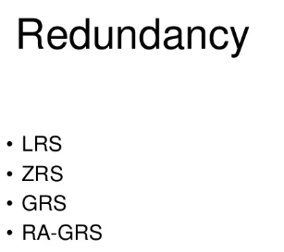
Redundancy Tiers of Storage

Slide 6
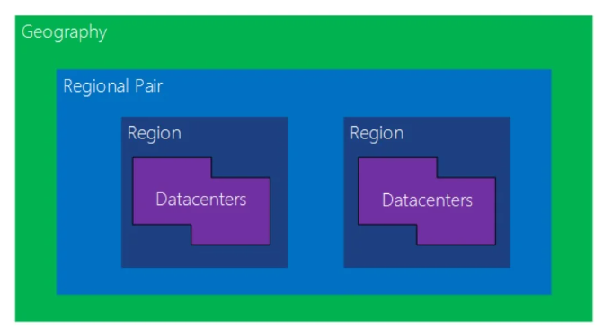
Azure Region

Slide 7
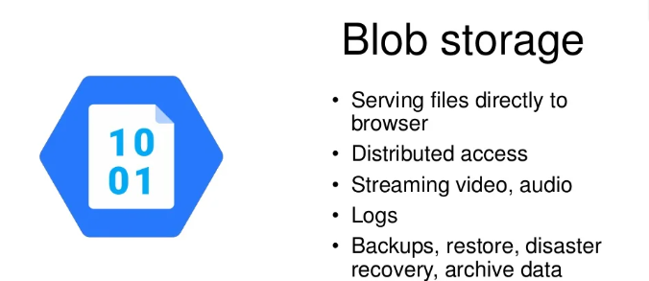
Azure Blob Storage

Slide 8
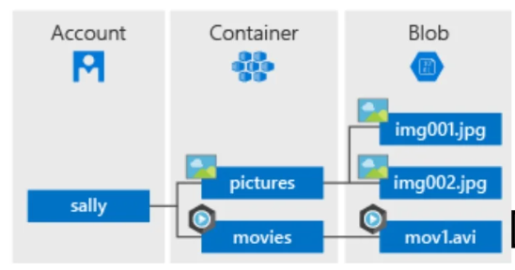
Blob Storage Structure

Slide 9
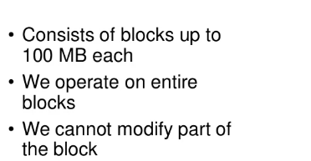
Block Blob

Slide 10
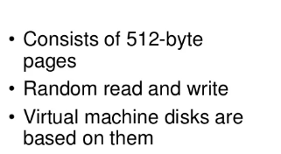
Page Blob

Slide 11
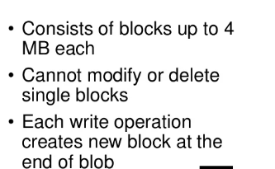
Append Blob

Slide 12
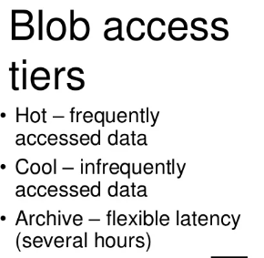
Blob Access Tiers

Slide 13
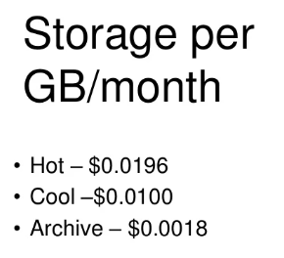
Storage Cost per Month

Slide 14
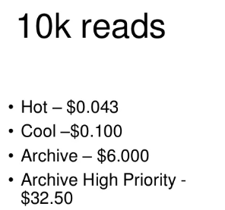
10k Reads

Slide 15
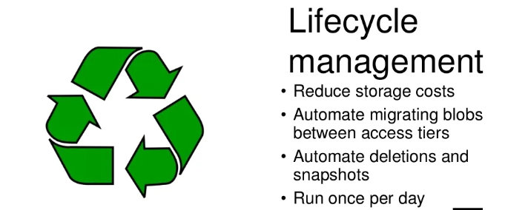
Blob Storage Lifecycle Management

Slide 16
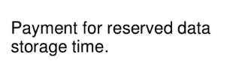
Early Deletion

Slide 17
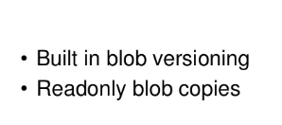
Snapshots

Slide 18
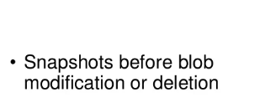
Soft Delete

Slide 19
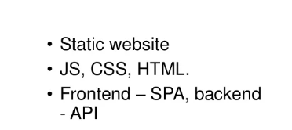
Static Hosting

Slide 20
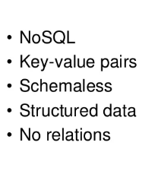
Table Storage

Slide 21
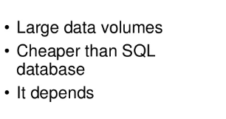
Usage Scenarios

Slide 22
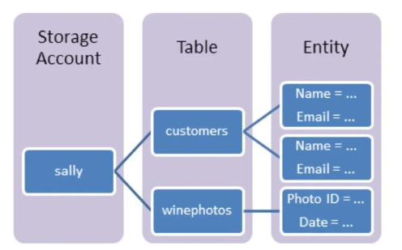
Structure

Slide 23
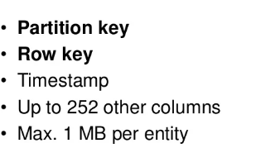
Table Structure

Slide 24
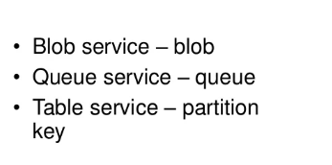
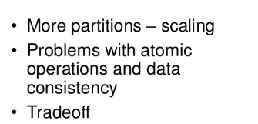
Partitioning

Slide 25
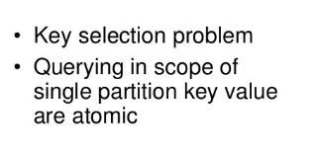
Partition Key & Row Key
Identifies the record in a the partition

Slide 26
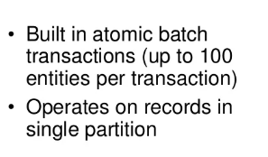
Entity Group Transaction

Slide 27
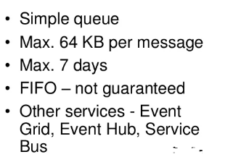
Queue Storage

Slide 28
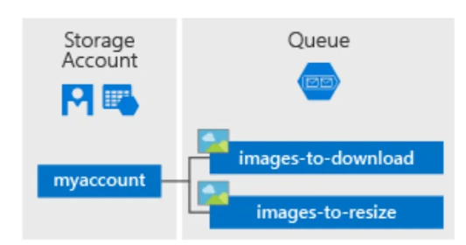
Queue Storage Structure

Slide 29
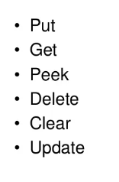
Queue Storage Operations

Slide 30
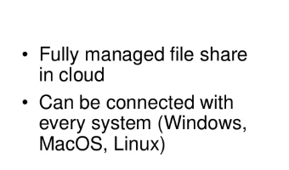
Azure File Share

Slide 31
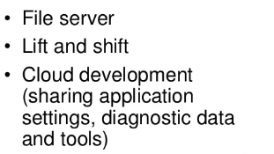
Usage Scenarios

Slide 32
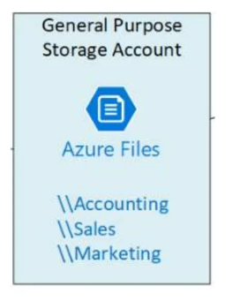
File Share Structure
File Share
Consists of File system architecture

Slide 33
Shared Access Signature (SAS)
Generated URI
Permissions for selected resources
Time range
Cannot be directly cancelled

Slide 34
Stored Access Policy
Policy with similar settings as SAS
SAS can be based on it
Easily cancellable
Cannot be set on Storage Account level (like SAS)

Slide 35
Storage Analytics
Already defined tables and blob containers
20 TB storage independent of storage account limits
Some analytics operations are billed

